Slide 1
DATS-6101 GROUP PROJECT
Mass Shootings in America
- Julius Frank, Natasha Vij, Meg Fitzgerald -

Slide 2

Meet Our Team
MEG ELLIOTT FITZGERALD
NATASHA VIJ
JULIUS FRANK
Collaborated to define SMART question
Performed the EDA
Wrote Section I and final draft of essay
Added the visualizations to essay with descriptions
Built PowerPoint framework
Created EDA slides (slides 6-8)
Found dataset
Collaborated to define SMART question
Assisted in testing
Wrote preliminary draft of essay/edited final draft of essay
Created Introductory slides (slides 3-5)
Collaborated to define SMART question
Conducted statistical testing
Provided general python knowledge and expertise
Assisted in creation of visualizations
Created Conclusion slides (slides 9-11)

Slide 3
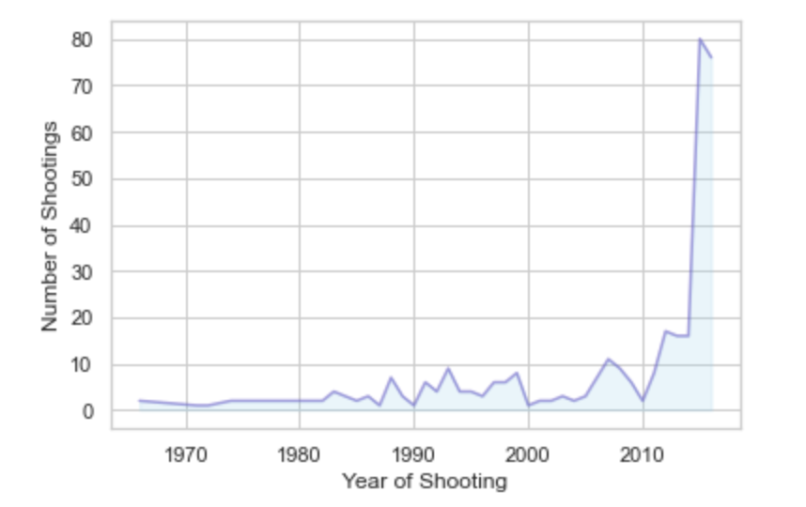
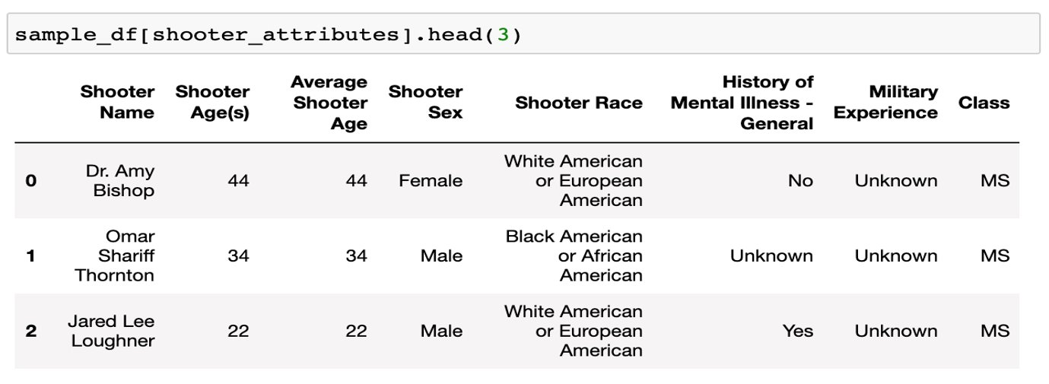
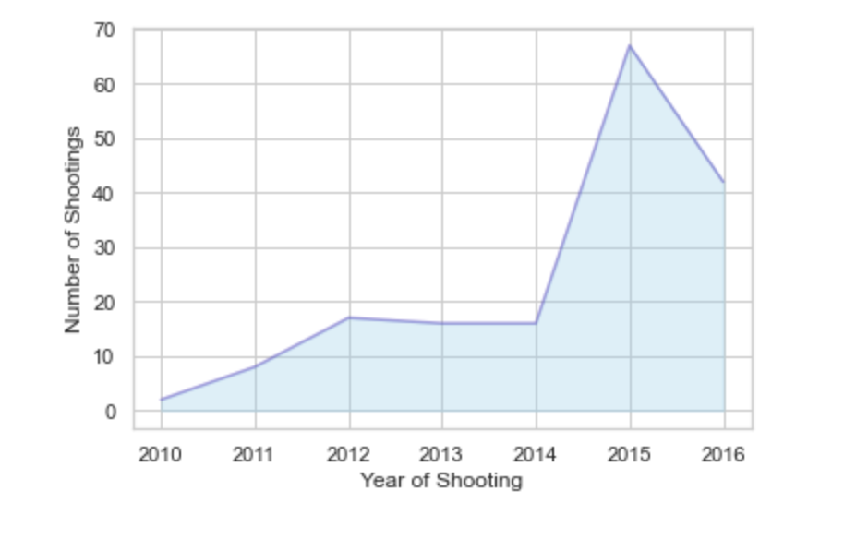
Standford Mass Shootings in America (MSA)
MSA is a dataset created by the Stanford Geospatial Center
Started collecting after Sandy Hook Shooting in 2012
Collects data through online sources

Slide 4
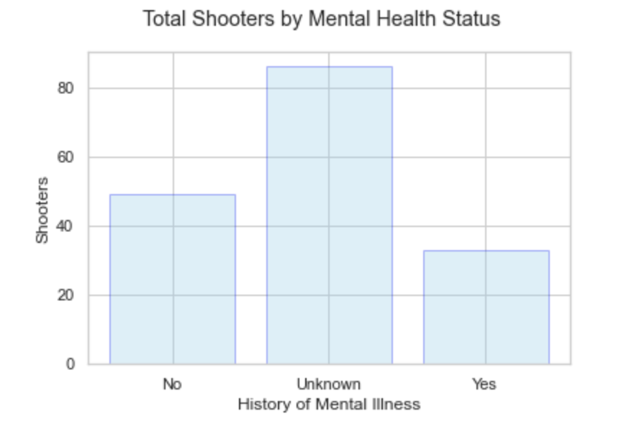
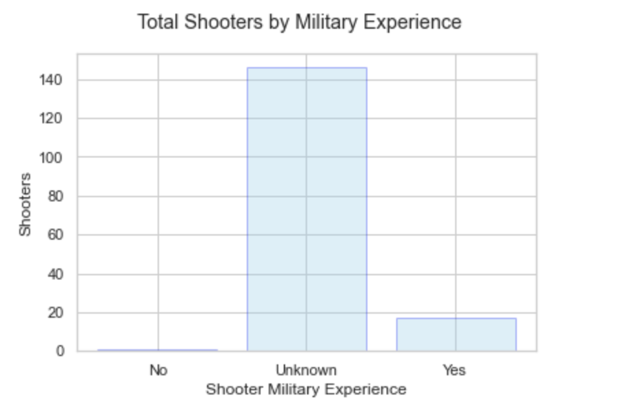
Dataset Limitations

Slide 5
SMART Question
Initial SMART Question:
Is the contemporary mass shooter in America similar to the average American demographically regarding age, race, and sex?
Refined SMART Question:
Is the contemporary mass shooter in America similar to the average American demographically relating to age, race, and sex?

Slide 6
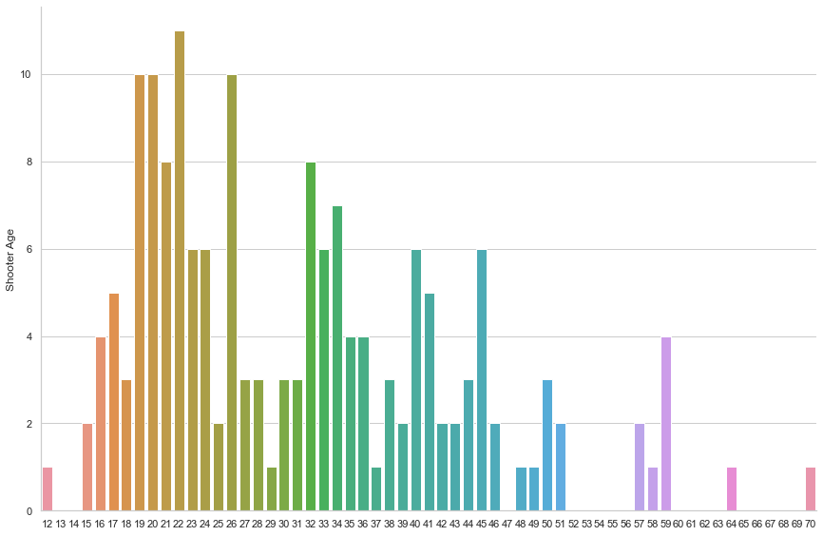
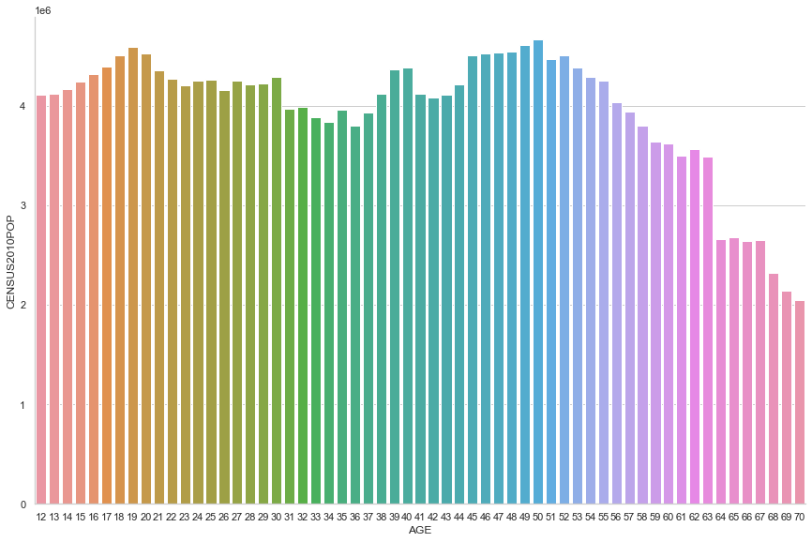
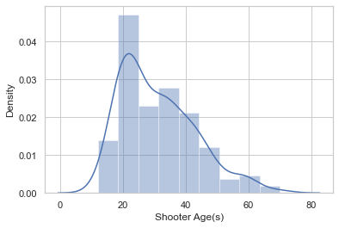
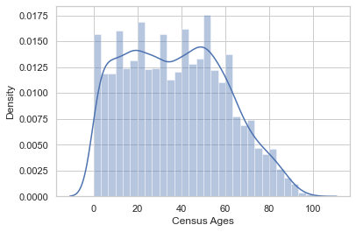
Exploring Age
SHOOTER AGE SKEWS YOUNGER
Shooter age peaks around 20-25 years old, as does the US population.
SHOOTER AGE IS UNCHARACTERISTICALLY UNIMODAL
The US population has a second peak around the age of 60, noticeably absent from the shooter dataset.

Slide 7
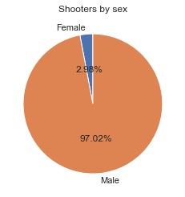
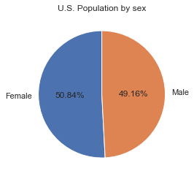
Exploring Sex
SHOOTERS ARE MORE OFTEN MEN
Only three percent of shooters are female, compared to roughly half of US citizens.

Slide 8
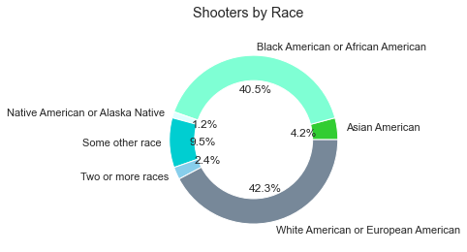
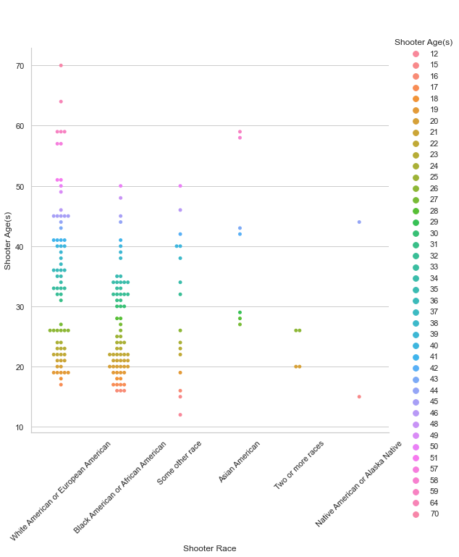
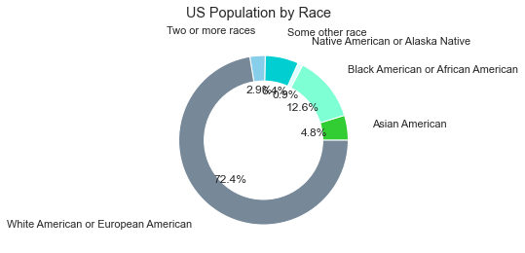
Exploring Race
BLACK AMERICANS ARE OVERREPRESENTED
COMPARED TO THE US POPULATION
All other minority populations are roughly unchanged.
BLACK SHOOTERS SKEW YOUNGER
The Black shooter group also demonstrates a bimodality that comes closer to mirroring the US population than the white shooter group.

Slide 9
Statistical Test Results
Test | Attribute | Test Statistic | p-value
Z-test | Age | Z = -6.865 | p < 0.01
χ^2 test | Race | χ^2 = 1719434814 | p < 0.01
χ^2 test | Gender | χ^2 = 308919043 | p < 0.01

Slide 10
Conclusion
There is overwhelming evidence that the average mass shooter is demographically different from the average American
They lean younger
They are almost always male
Overwhelmingly White or African American

Slide 11
Policy recommendation and future research
Interventions against mass shootings, such as mental health services, must target the demographics that are most often the perpetrators of mass shootings (Young, White or African-American males)
Future research should focus on discovery of additional characteristics shared by the at-risk population (perhaps political affiliation, economic class, or mental health history)

